Slide 1
Media Training Workshop in Preparation for the COP20
Understanding the Science of Climate Change
R. K. Pachauri
16 October 2014, Lima, Perú

Slide 2
Human influence on the climate system is clear and has been detected in warming of the atmosphere and the ocean, in changes in the global water cycle, in reductions in snow and ice, in global mean sea level rise, and in changes in some climate extremes.
- IPCC AR5 Working Group I
Source : IPCCAR5

Slide 3
The IPCC Fifth Assessment Report
A clear and up to date view of the current state of scientific knowledge relevant to climate change.
Working group I
The Physical Science Basis
259 authors
39 countries
54,677 comments
2 million gigabytes of numerical data from climate model simulations
Over 9200 scientific publications cited
Working Group II
Impacts, Adaptation and Vulnerability
309 authors
70 countries
50,444 comments
Over 12,000 scientific references cited
Working Group III
Mitigation of Climate Change
235 authors
57 countries
38,315 comments
Close to 1200 scenarios of socioeconomic development analyzed
Close to 10,000 references to literature
The Synthesis Report will be released in Copenhagen on 2nd November 2014
Source : IPCC AR5

Slide 4
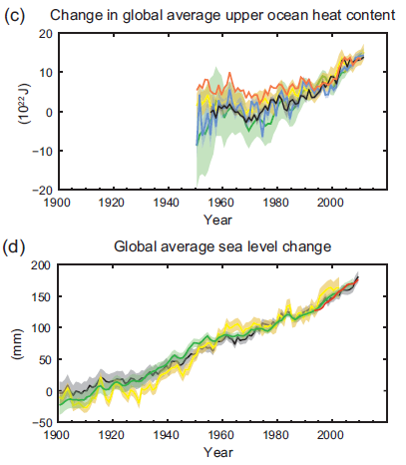
Observed changes in the climate system
Climate change is unequivocal
The oceans have warmed and risen
The amounts of snow and ice have diminished
Sea level has risen
The concentrations of greenhouse gases have increased
Source : IPCC AR5

Slide 5
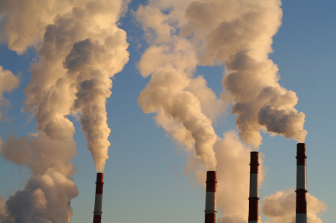
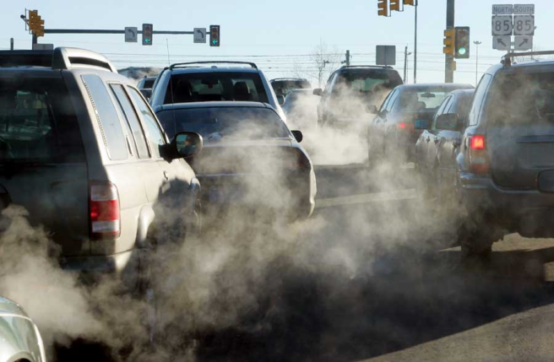
Human influence of the climate system is clear
Understanding the causes
95% certainty that human influence has been the dominant cause of the observed warming since the mid-20th century
Since the 1950s, many of the observed changes are unprecedented over decades to millennia.
Limiting climate change will require sustained and substantial reductions in greenhouse gas emissions
Source : IPCC AR5
Source : IPCC AR5

Slide 6
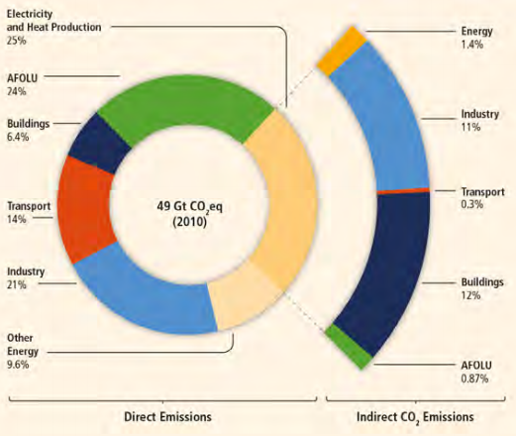
Trends in GHGs and their drivers
Total anthropogenic GHG emissions were the highest in human history from 2000 to 2010
Greenhouse gas emissions by economic sectors
Globally, economic and population growth continue to be the most important drivers of increases in CO2 emissions from fossil fuel combustions
These are expected to continue to drive emissions growth without additional efforts to reduce GHG emissions.
Source : IPCC AR5

Slide 7
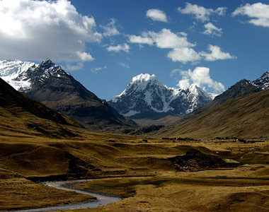
Observed climate change in Perú
In CA and SA, decadal variability and changes in extremes have been affecting large sectors of the population, especially those more vulnerable and exposed to climate hazards.
Strong negative precipitation trends and warming detected in the Mantaro Valley, Perú
Air temperature increases in the southern Andes of Perú (1964-2006)
In the Peruvian western Amazonia, mean rainfall for 1964–2003 has decreased
Rapid retreat and melting of the tropical Andes glaciers of Venezuela, Colombia, Ecuador, Perú and Bolivia
7 out of 9 river basins have probably crossed a critical threshold, exhibiting a decreasing dry-season discharge in the Cordillera Blanca of Perú
Source : IPCC AR5

Slide 8
Extreme events during and by the end of the 21st Century
It is very likely that the length, frequency, and/or intensity of warm spells or heat waves will increase over most land areas
Under some scenarios, a 1-in-20 year hottest day is likely to become a 1-in-2 year event in most regions
It is likely that the frequency of heavy precipitation or the proportion of total rainfall from heavy falls will increase over many areas of the globe
Source : IPCC SREX

Slide 9
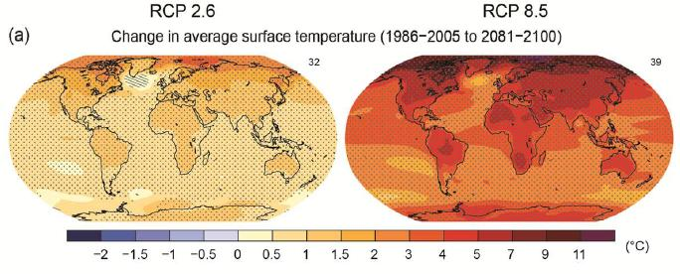
Future changes in the climate system
Warming will continue beyond 2100 under all RCP scenarios except RCP2.6.
is likely to exceed 1.5°C relative to 1850 to 1900 for all RCP scenarios except RCP2.6.
is likely to exceed 2°C for RCP6.0 and RCP8.5
is more likely than not to exceed 2°C for RCP4.5.
Global surface temperature change for the end of the 21st century:
Source : IPCC AR5

Slide 10
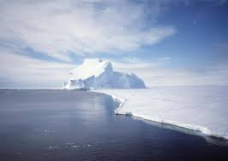
Abrupt and irreversible impacts
Most aspects of climate change will persist for many centuries even if emissions of CO2 are stopped.
Sustained mass loss by ice sheets (some of which irreversible) would cause larger sea level rise.
Sustained warming greater than some threshold (greater than about 1°C but less than about 4°C global mean warming with respect to pre-industrial) would lead to the near-complete loss of the Greenland ice sheet over a millennium or more, causing a global mean sea level rise of up to 7 m.
Source : IPCC AR5

Slide 11
Impacts on food security
All aspects of food security are potentially affected by climate change, including food access, utilization, and price stability. Impacts will occur in the context of rapidly rising crop demand.
Projected negative impacts for production of wheat, rice and maize for local temperature increases of 2°C or more above late-20th-century levels, without adaptation.
Redistribution of marine fisheries catch potential poses risk of reduced supplies, income, and employment.
Source : IPCC AR5

Slide 12
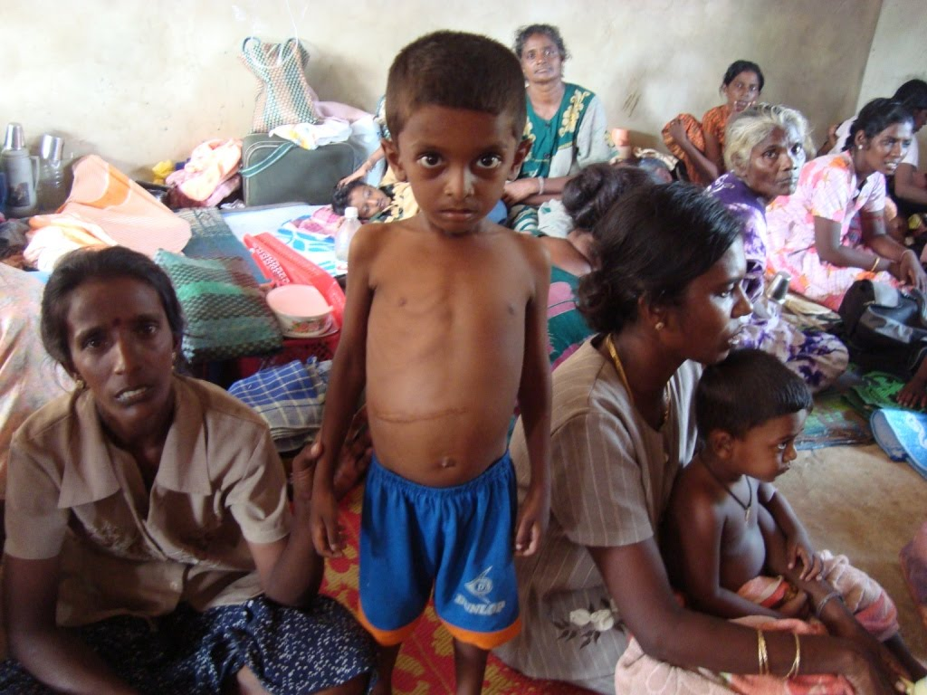
Impacts on human health
Throughout the 21st century, climate change is expected to lead to increases in ill-health in many regions and especially in developing countries with low income.
Increased likelihood of:
Injury, disease, and death due to more intense heat waves and fires.
Under-nutrition from diminished food production in poor regions.
Risks from food- and water- and vector-borne diseases.
Source : IPCC AR5

Slide 13
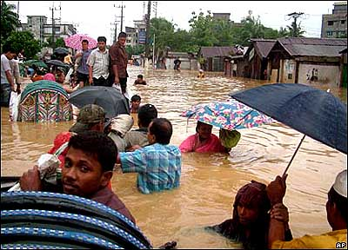
Impacts on human security
Climate change over the 21st century can increase:
Displacement of people, particularly in developing countries with low income.
Risks of violent conflicts by amplifying poverty and economic shocks.
Rivalry among states due to potential transboundary impacts of climate change, such as changes in sea ice, shared water resources, and pelagic fish stocks.
Source : IPCC AR5

Slide 14
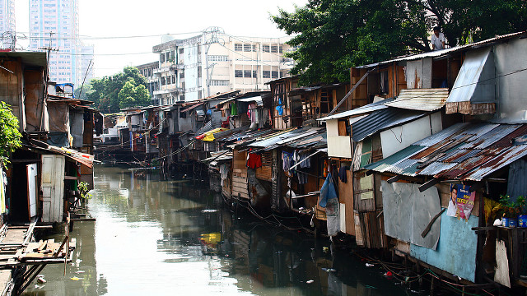
Impacts of climate change on urban areas
Climate change will have profound impacts on a broad spectrum of city functions, infrastructure and services and will interact with and may exacerbate many existing stresses.
The risks: rising sea levels, storm surges, heat stress, extreme precipitation, flooding, landslides, drought, increased aridity, water scarcity and air pollution.
Risks can have widespread negative impacts on people, economies and ecosystems
Risks are amplified for those who live in informal settlements with inadequate provision for adaptation
Source : IPCC AR5

Slide 15
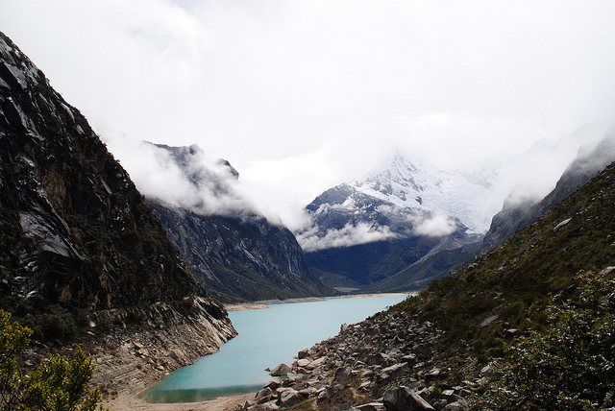
Projected impacts in Perú
2%–30% annual discharge decrease in the Santa River once the glaciers are completely melted
Projections estimate impacts of glacier melt to between US$212 million to US$ 1.5 billion due to losses of hydropower generation
Perú is one of the most vulnerable countries to climate change impacts on fisheries (due to warming, species shift, importance of fisheries to the national economy and diet)
Climate change may alter plant diseases and potato late blight severity is expected to increase in Perú
Source : IPCC AR5

Slide 16
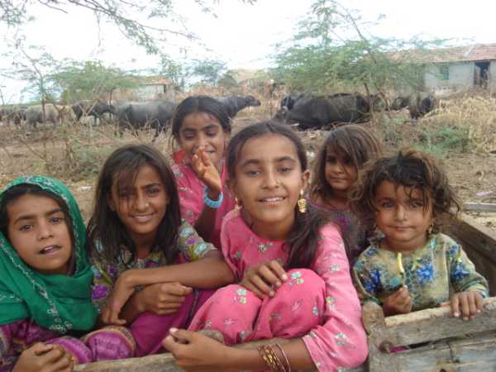
Implications for development
Climate-related hazards exacerbate other stressors, often with negative outcomes for
livelihoods, especially for people living in poverty.
Throughout the 21st century, climate-change impacts are projected to:
Slow down economic growth
Make poverty reduction more difficult
Further erode food security
Prolong existing and create new poverty traps, particularly in urban areas and emerging hotspots of hunger
Source : IPCC AR5

Slide 17
Fatalities are higher in developing countries
From 1970-2008, over 95% of natural-disaster-related deaths occurred in
developing countries
Source : IPCC SREX

Slide 18
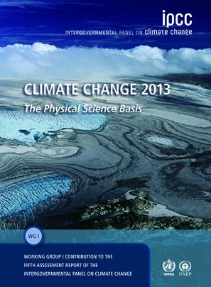
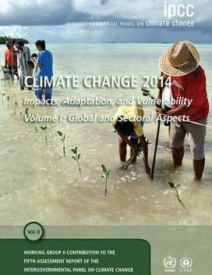
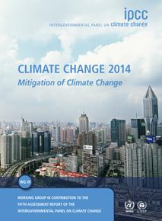
Adaptation and Mitigation
IPCC Fifth Assessment Report
“Climate-resilient pathways combine adaptation and mitigation to reduce climate change and its impacts. Since mitigation reduces the rate and magnitude of warming, it also increases the time available for adaptation to a particular level of climate change, potentially by several decades.”
Source : IPCC AR5

Slide 19
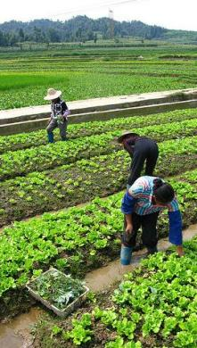
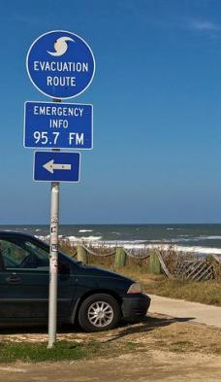
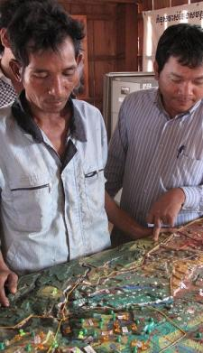
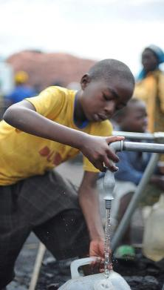
There are strategies that can help manage disaster risk now and also help improve people’s livelihoods and well-being
The most effective strategies offer development benefits in the relatively near
term and reduce vulnerability over the longer term
Source : IPCC SREX

Slide 20
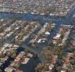
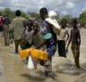
Effective risk management and adaptation are tailored to local and regional needs and circumstances
Changes in climate extremes vary across regions
Each region has unique vulnerabilities and exposure to hazards
Effective risk management and adaptation address the factors contributing to exposure and vulnerability
Source : IPCC SREX

Slide 21
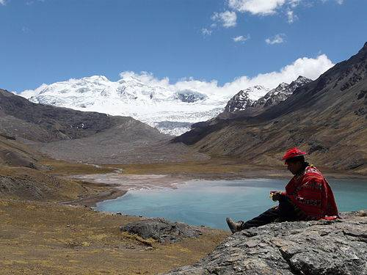
Adaptation experience in Perú
Constitutional and legal reforms for more efficient water resources management in coordination between 7 countries in SA and CA including Perú; but further implementation is required
The management of ENSO-related events in Perú via participatory or risk reduction approaches
Crop diversification in the Peruvian Andes to suppress pest outbreaks and pathogen transmission
Address constraints on access to key resources for reducing vulnerability, as shown by studies with indigenous farmers in highland Perú
Source : IPCC AR5

Slide 22
Impacts of mitigation on GDP growth
Delaying additional mitigation further increases mitigation costs in the medium to long term
GDP
GDP without mitigation
Loss in global consumption in 2100: 4.8% (median)
Loss in global consumption in 2050: 3.4% (median)
Loss in global consumption in 2030: 1.7% (median)
GDP with stringent mitigation (reaching ≈ 450 ppm CO2eq in 2100)
Current
Time
2030
2050
2100
Source : IPCC AR5

Slide 23
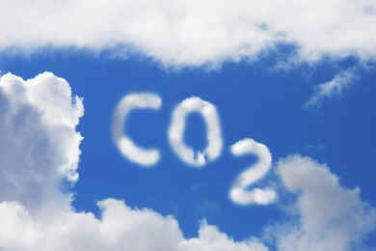
Stringent mitigation scenarios
Characteristics of scenarios reaching levels of about 450 ppm CO2eq by 2100 (likely chance to keep temperature change below 2C relative to preindustrial levels):
Lower global GHGs in 2050 than in 2010 (40% to 70% lower globally)
Emissions levels near zero GtCO2eq or below in 2100
More rapid improvements in energy efficiency
A tripling to nearly a quadrupling of the share of energy supply from renewables by 2050
Many scenarios reaching 450, 500 and 550 ppm CO2eq by 2100 require widespread deployment of BECCS, afforestation, and other CDR technologies post 2050
Source : IPCC AR5

Slide 24
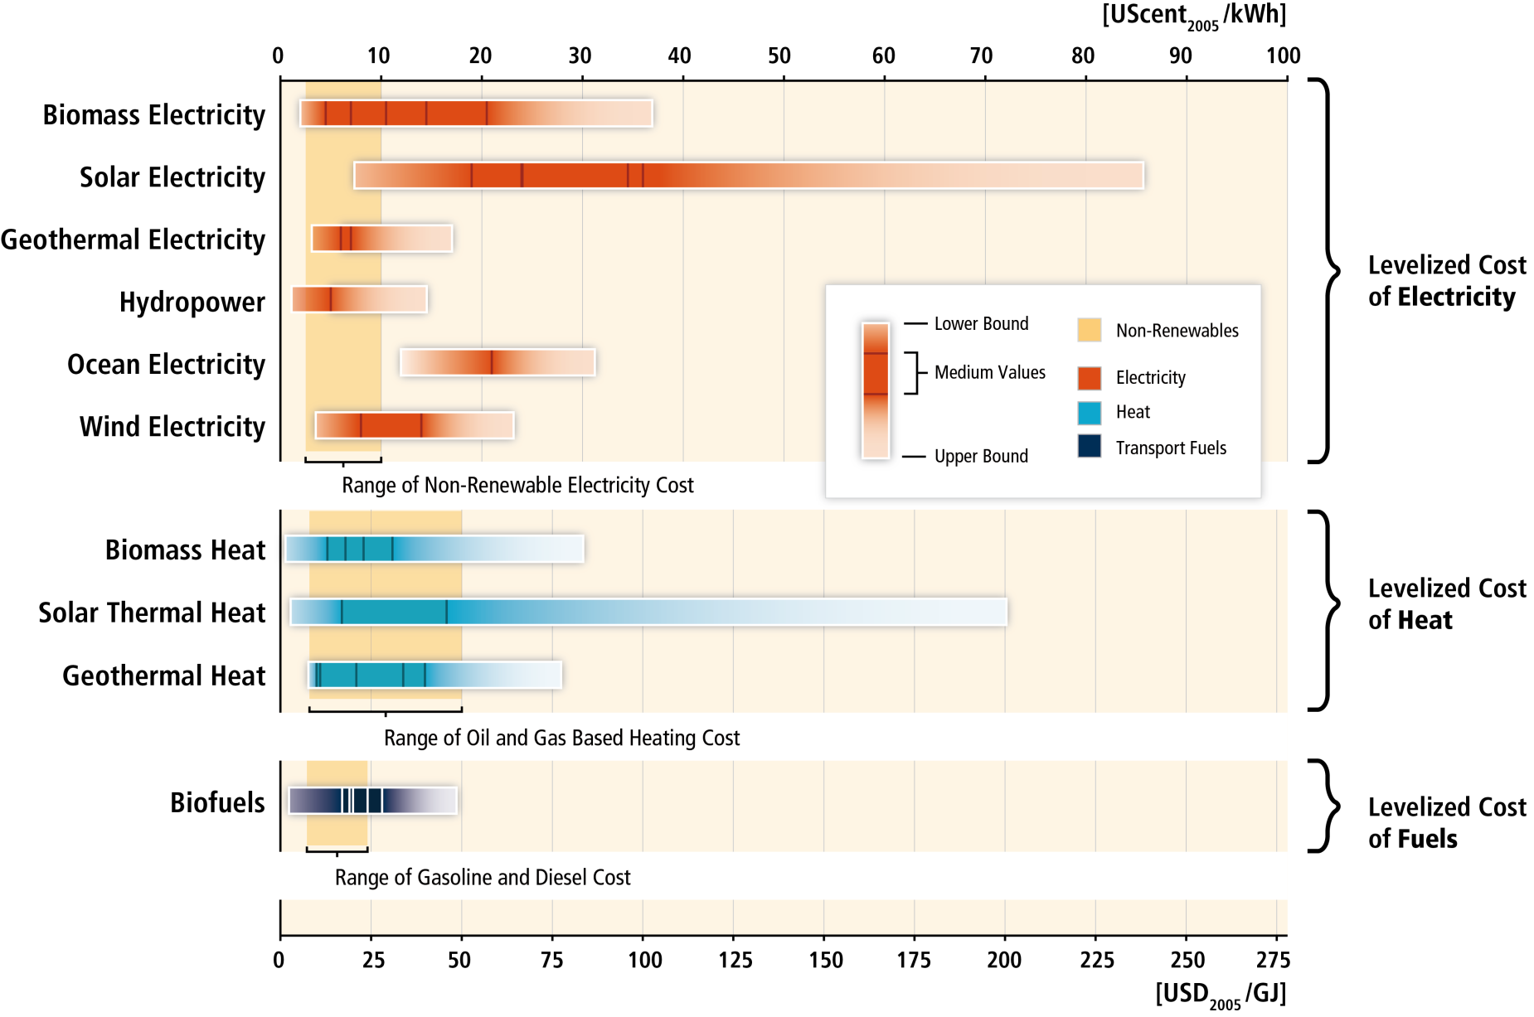
RE costs are still higher than existing energy prices but in various settings RE is already competitive.
Source : IPCC SRREN

Slide 25
Co-benefits
The intersections of mitigation and adaptation with other societal goals, if well managed, can strengthen the basis for undertaking climate action:
Improved energy efficiency and security
Cleaner energy sources
Air quality and human health
Reduced energy and water consumption in urban areas
Sustainable agriculture and forestry
Protection of ecosystems for carbon storage
Source : IPCC AR5

Slide 26
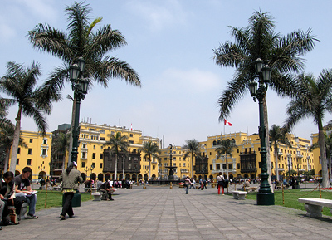
Integration of climate change into policies
C40 Cities- Climate Leadership Group (ICLEI) and Lima’s Metropolitan Strategy to CCA
Growing awareness of CA and SA governments on the need to integrate climate change and future climate risks in their policies
18 regional Non-Annex countries, including Perú have already published their 1st and/or 2nd National Communication to the UNFCCC allowing to measure their emissions and to assess their present and future vulnerability.
Source : IPCC AR5

Slide 27
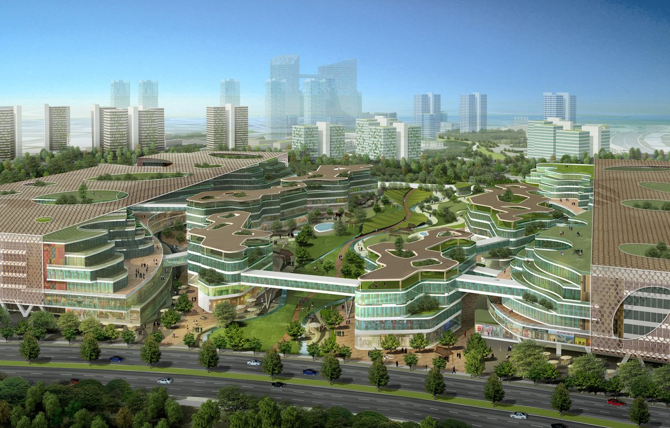
Climate change and sustainable development
Governing a transition toward an effective climate response and sustainable development pathway is a challenge involving rethinking our relation to nature.
A stable climate is one component of sustainable development.
Designing an effective climate policy involves “mainstreaming” climate in the design of sustainable development strategies.
Behaviour, lifestyle and culture can substantially contribute to lowering emissions:
Changes in consumption patterns
Dietary changes
Reduction in food wastes
Source : IPCC AR5

Slide 28
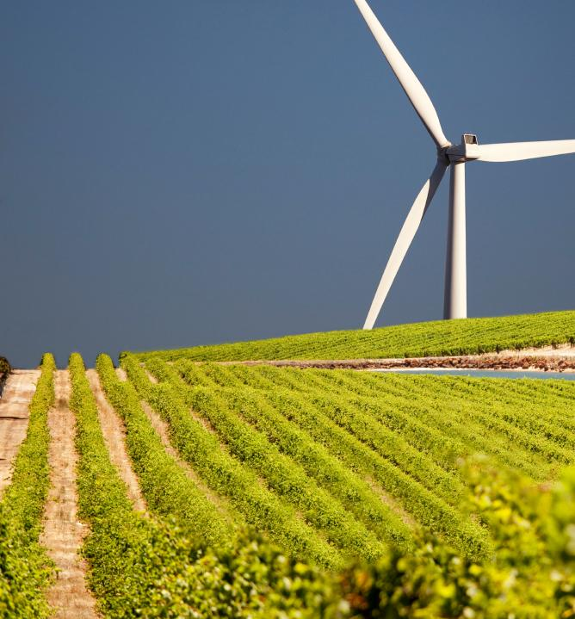
Climate change and equity
Limiting the effects of climate change is necessary to achieve SD and equity, including poverty eradication.
Issues of equity, justice, and fairness arise with respect to mitigation and adaptation:
Different past and future contributions to the accumulation of GHGs in the atmosphere
Varying challenges and circumstances
Different capacities to address mitigation and adaptation.
Options for equitable burden-sharing can reduce the potential for the costs of climate action to constrain development.
Equitable outcomes can lead to more effective cooperation
Source : IPCC AR5

Slide 29
“A technological society has two choices. First it can wait until catastrophic failures expose systemic deficiencies, distortion and self-deceptions…
Secondly, a culture can provide social checks and balances to correct for systemic distortion prior to catastrophic failures.”
- Mahatma Gandhi
“Speed is irrelevant if you are going in the wrong direction”
- Mahatma Gandhi

Slide 30
Media Information
2nd November: press conference to present the Synthesis Report in Copenhagen, with UN Secretary-General Ban Ki Moon, IPCC Chairman R K Pachauri, WMO Secretary-General Michel Jarraud, IPCC Secretary Renate Christ, and Peruvian Environment Minister Manuel Pulgar-Vidal
The press conference will be webcast live at 5:00AM PET
The Synthesis Report and the press release will be available under embargo one day before the press conference – registration online
After the press conference IPCC authors and officials will be available for interview, 7:00 AM PET onwards, in person or by phone. Requests for interviews can be made online.
Contact: Mr Jonathan Lynn, IPCC Senior Communications Officer, jlynn@wmo.int and Ms Noemie Leprince-Ringuet, Synthesis Report Technical Support Unit, noemie.ringuet@teri.res.in

